Slide 1

Boosting Algorithm
Ensemble Techniques

Slide 2
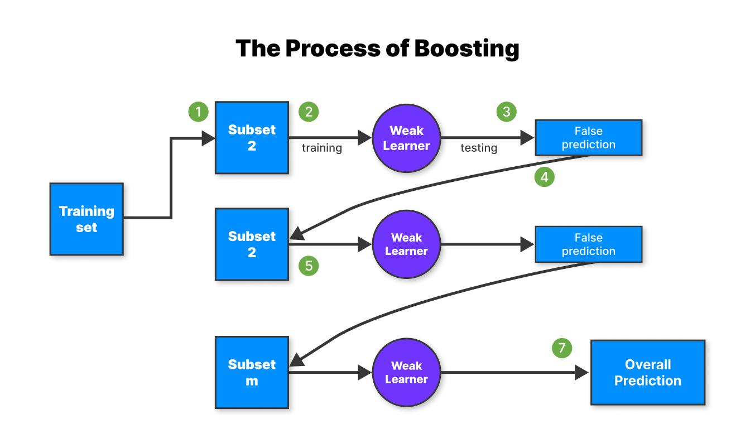
Boosting combines the weak learners to form a strong learner.
Training models sequentially, each one trying to correct the errors made by the previous models.
The final prediction combines the outputs of all models, usually through weighted voting or averaging.

Slide 3
Type of Boosting Algorithm
- Gradient Boosting
- AdaBoost (Adaptive Boosting)
- XGBoost

Slide 4
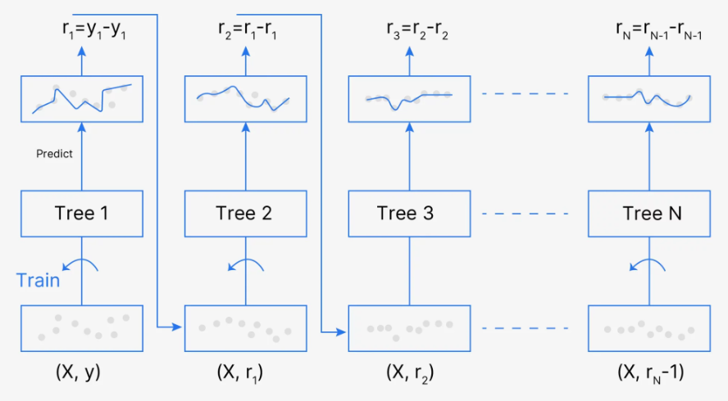
Gradient Boosting Machine
[Initial Prediction] --> [Compute Residuals] --> [Base Estimator 1 (on Residuals)] --(Update Prediction)--> [Compute New Residuals] --> [Base Estimator 2] --> ... --> [Final Model]
Gradient Boosting is a machine learning technique for regression and classification problems. It builds models in a sequential manner, where each new model aims to correct the errors made by its predecessor. The models are typically decision trees, and the final prediction is a weighted sum of all individual models.

Slide 5
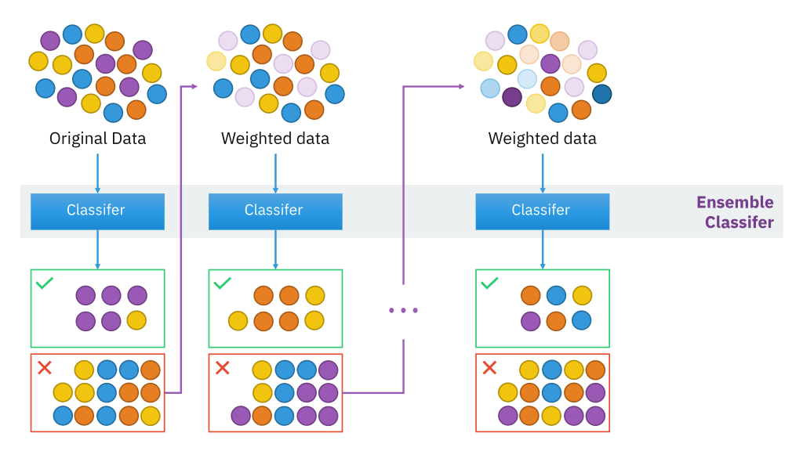
Adaboosting Algorithm
[Data with Weights] --> [Base Estimator 1] --(Adjust Weights)--> [Base Estimator 2] --(Adjust Weights)--> ... --> [Base Estimator N]
\ /
\--(Weighted Combination of Estimators)---> [Final Model]

Slide 6
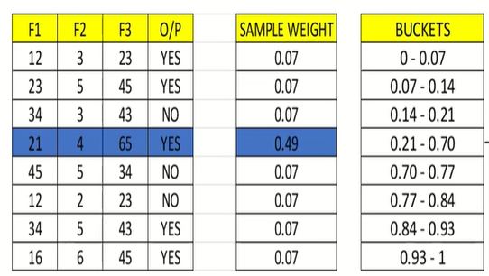
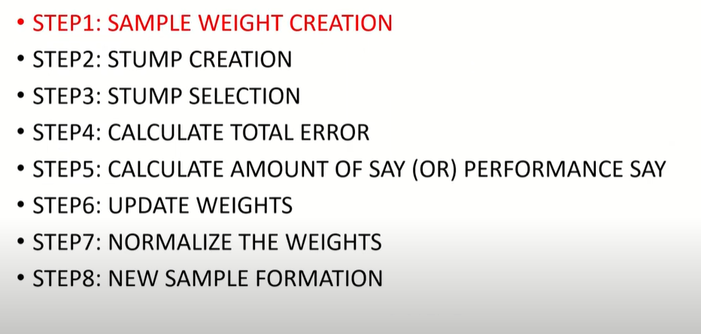
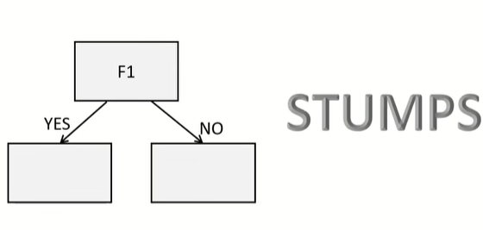


Adaboosting Algorithm
Stump selection based on Minimum R2 Score
Total Error is the sum of all the errors in the classified record for sample weights.
The main difference between these two algorithms is that Stochastic Gradient Boosting has a fixed base estimator (known as a weak learner or base learner) and decision trees. In contrast, in AdaBoost, we can change the base estimator to suit our needs.

Slide 7
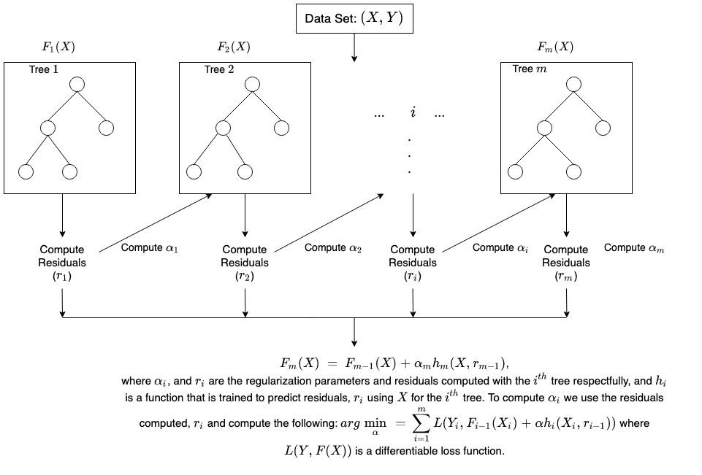
XGBoost (Extreme Gradient Boosting)
XGBoost is an optimized implementation of gradient boosting designed for speed and performance. Developed by Tianqi Chen and collaborators, it introduces advanced features that make it stand out from traditional gradient boosting algorithms.
One of the most important points is that XGBM implements parallel preprocessing (at the node level) which makes it faster than GBM
XGBoost also includes a variety of regularization techniques that reduce overfitting and improve overall performance. You can select the regularization technique by setting the hyperparameters of the XGBoost algorithm

